Slide 1
DESIGN RULES – part 2
Session 6

Slide 2
Rule : 3 Make the common case fast.
We can never avoid constants in the instructions.
Particularly, when it comes to arithmetic instructions, constants remain inevitable.
Hence, use it as we used with Immediate Instructions as it would certainly be faster than if is getting loaded from memory.

Slide 3
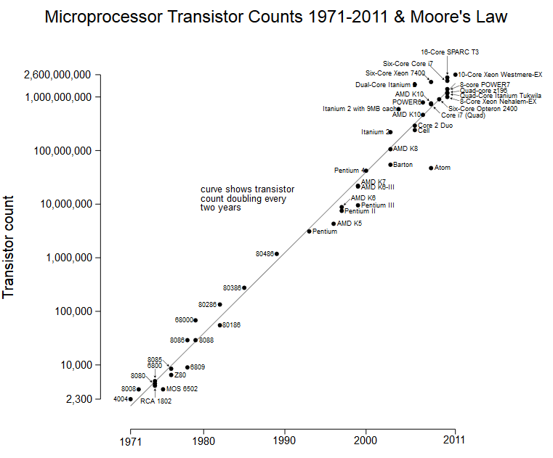
Remember this – This is for good!
The observation made in 1965 by Gordon Moore, co-founder of Intel, that the number of transistors per square inch on integrated circuits had doubled every year since the integrated circuit was invented. Moore predicted that this trend would continue for the foreseeable future.
MOORE’s law is simply superb! You can’t ignore!

Slide 4
Rule : 4 We have to accept some compromises to get good design in place.
By now, it would have been clearer for the readers that, all MIPS instructions are of same size. I.e. same instruction length. 32 bits.
This has forced the designers to provide 3 different formats – I J and R type to meet the requirements.
This is a compromise. Undoubtedly.

Slide 5
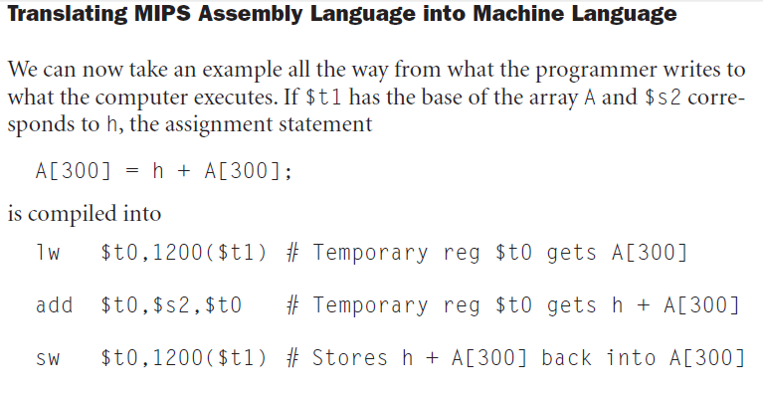
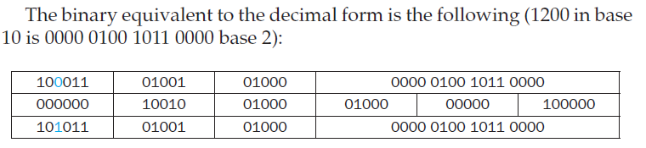
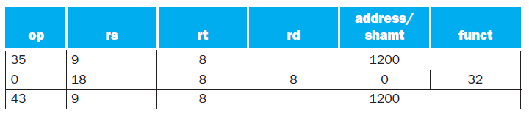
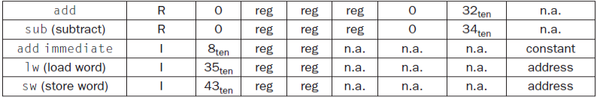
What is the MIPS machine language code for these three instructions?
The lw instruction is identified by 35
The base register 9 ($t1) is
specified in the second field (rs)
Destination register 8 ($t0) is
specified in the third field (rt).
The offset to select A[300] is found in
the final field (address).
let’s first represent the machine language instructions using decimal numbers . . .
NOTE: ...2048 1024 512 256 128 64 32 16 8 4 2 1

Slide 6
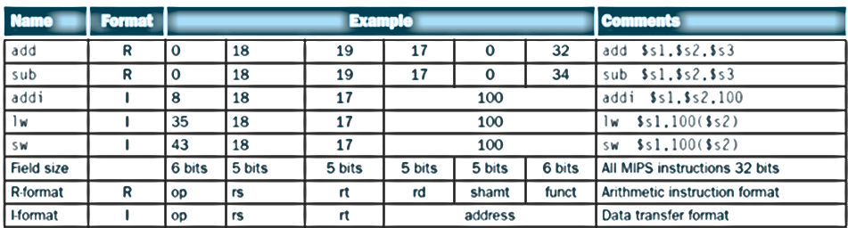
Summary for you…
Courtesy: Patterson, David A & J L Hennessy, Computer Organization & Design 3rd Ed.

